Slide 1
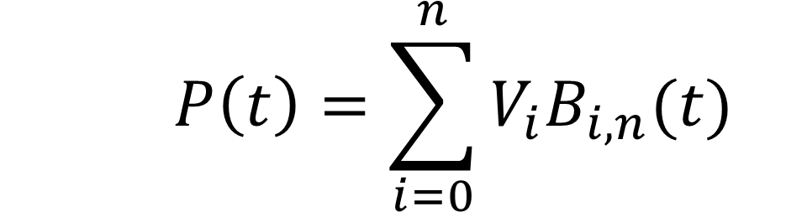
Derivation of Algorithm

Slide 2
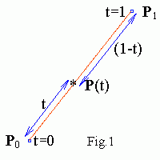
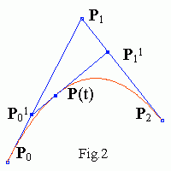

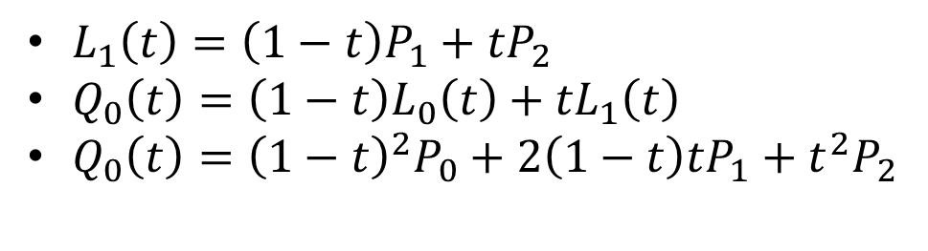
Linear Bezier Curve
Quadratic Bezier Curve
$L_{0}\left(t\right)=\left(1−t\right)P_{0}+{tP}_{1}$
$L_{1}\left(t\right)=\left(1−t\right)P_{1}+{tP}_{2}$
$Q_{0}\left(t\right)=\left(1−t\right)L_{0}\left(t\right)+{tL}_{1}\left(t\right)$
$Q_{0}\left(t\right)={\left(1−t\right)}^{2}P_{0}+{2\left(1−t\right)tP}_{1}+t^{2}P_{2}$

Slide 3
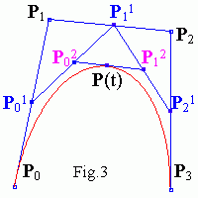

Cubic Bezier Curve
$L_{2}\left(t\right)=\left(1−t\right)P_{2}+{tP}_{3}$
$Q_{1}\left(t\right)=\left(1−t\right)L_{1}\left(t\right)+{tL}_{2}\left(t\right)$
$C_{0}\left(t\right)=\left(1−t\right)Q_{0}\left(t\right)+{tQ}_{1}\left(t\right)$
$C_{0}\left(t\right)={\left(1−t\right)}^{3}P_{0}+{3{\left(1−t\right)}^{2}tP}_{1}$ $+3\left(1−t\right)t^{2}P_{2}+t^{3}P_{3}$

Slide 4

$C_{0}\left(t\right)={1\left(1−t\right)}^{3}P_{0}+{3{\left(1−t\right)}^{2}tP}_{1}+3\left(1−t\right)t^{2}P_{2}+1(t^{3}P_{3})$
$B_{i,n(t)}=\left( \begin{matrix}n \\ i\end{matrix} \right)t^{i}{(1−t)}^{n−i}$
$\left( \begin{matrix}n \\ i\end{matrix} \right)=\frac{n!}{i!\left(n−i\right)!}$

Slide 5
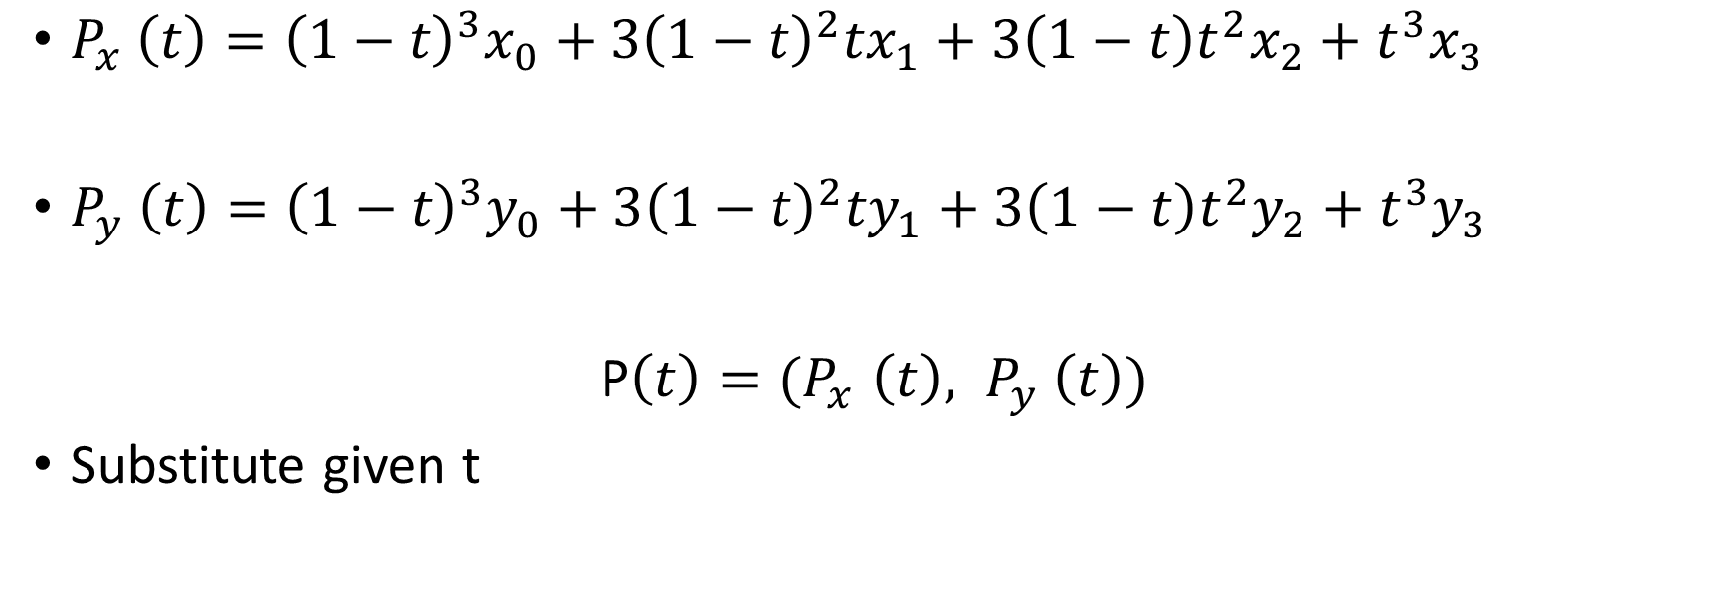
To find the coordinates of the point on the curve
$P_{x} \left(t\right)={\left(1−t\right)}^{3}x_{0}+{3{\left(1−t\right)}^{2}tx}_{1}+3\left(1−t\right)t^{2}x_{2}+t^{3}x_{3}$
$P_{y} \left(t\right)={\left(1−t\right)}^{3}y_{0}+{3{\left(1−t\right)}^{2}ty}_{1}+3\left(1−t\right)t^{2}y_{2}+t^{3}y_{3}$
P$\left(t\right){=(P}_{x}\left(t\right), P_{y} \left(t\right))$
Substitute given t

Slide 6

To find the tangent vector of the point on the curve
Derivative the previous equation found, P$\left(t\right){=(P}_{x}\left(t\right), P_{y} \left(t\right))$
P’$\left(t\right){=(P}_{x}\text{’}\left(t\right),P_{y}$’$\left(t\right))$
Substitute given t

Slide 7
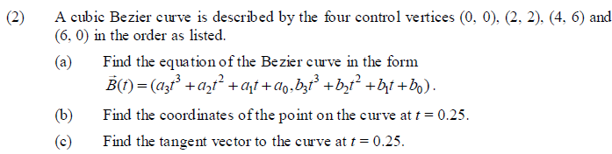
Example (from tut6 question 2)

Slide 8
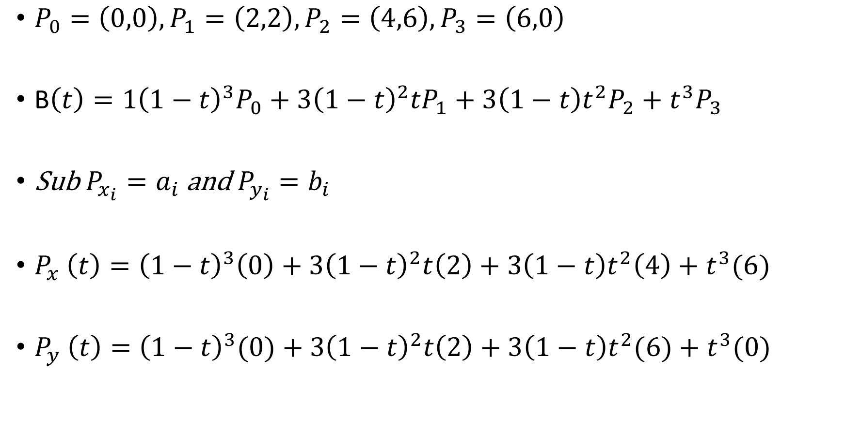
$P_{0}=\left(0,0\right), P_{1}=\left(2,2\right), P_{2}=\left(4,6\right), P_{3}=\left(6,0\right)$
B$\left(t\right)={1\left(1−t\right)}^{3}P_{0}+{3{\left(1−t\right)}^{2}tP}_{1}+3\left(1−t\right)t^{2}P_{2}+t^{3}P_{3}$
Sub $P_{x_{i}}=a_{i}$ and $P_{y_{i}}=b_{i}$
$P_{x} \left(t\right)={\left(1−t\right)}^{3}\left(0\right)+3{\left(1−t\right)}^{2}t\left(2\right)+3\left(1−t\right)t^{2}\left(4\right)+t^{3}(6)$
$P_{y} \left(t\right)={\left(1−t\right)}^{3}(0)+3{\left(1−t\right)}^{2}t\left(2\right)+3\left(1−t\right)t^{2}(6)+t^{3}(0)$

Slide 9
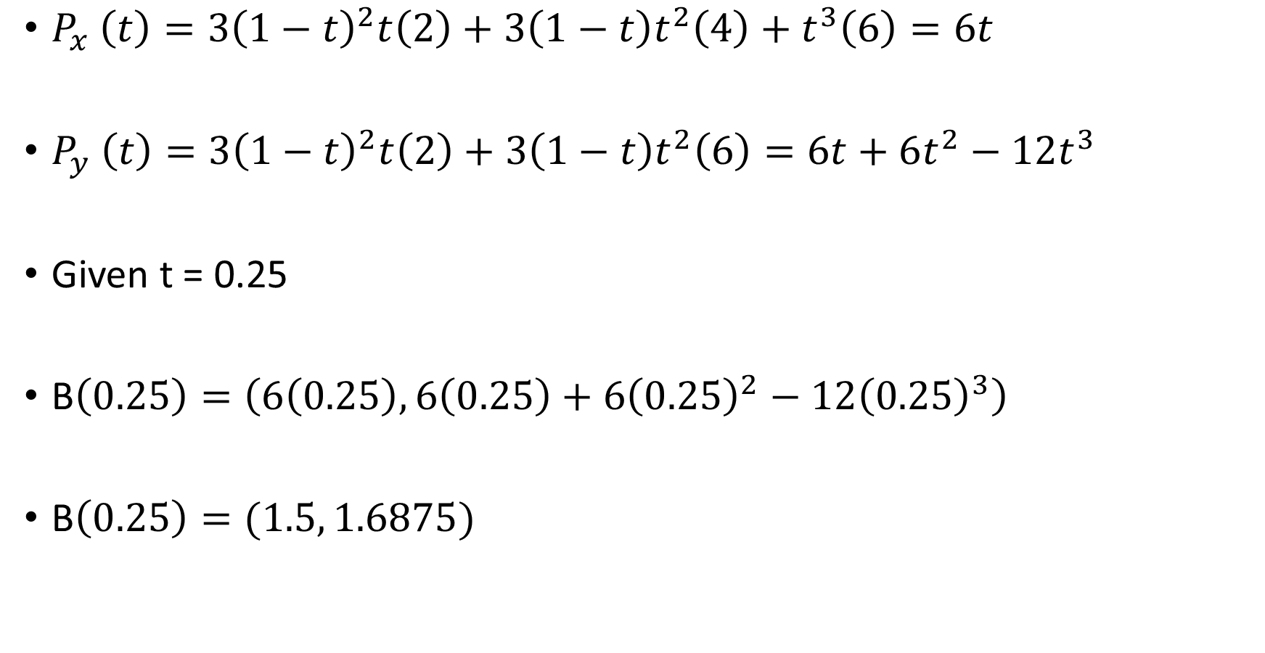
$P_{x} \left(t\right)=3{\left(1−t\right)}^{2}t\left(2\right)+3\left(1−t\right)t^{2}\left(4\right)+t^{3}\left(6\right)=6t$
$P_{y} \left(t\right)=3{\left(1−t\right)}^{2}t\left(2\right)+3\left(1−t\right)t^{2}\left(6\right)=6t+6t^{2}−12t^{3}$
Given t = 0.25
B$\left(0.25\right)=\left(6\left(0.25\right), 6\left(0.25\right)+6{\left(0.25\right)}^{2}−12{\left(0.25\right)}^{3}\right)$
B$\left(0.25\right)=(1.5, 1.6875)$

Slide 10

$$P_{x} ′\left(t\right)=6$$
$$P_{y} ′\left(t\right)=6+12t−36t^{2}$$
B’$\left(t\right){=(P}_{x}\text{’}\left(t\right),P_{y}$’$\left(t\right))$
Given t = 0.25
B’$\left(t\right)=(6, 6+12(0.25)−36{(0.25)}^{2}$)
B’$\left(t\right)=(6, 6.75)$

